Slide 1


Smart Home Security & Intruder Detection
Design and Simulation Using Combinational Logic
Course: Digital Logic Design | Group: Group 6 | Topic: Real-time combinational intruder detection circuit
Project Team Members (Group 6)
Sl. No. | Member Roll No. | Member Name
1 | 2620030506 | Sabeer
2 | 2620030518 | Sushma
3 | 2620030525 | Kaushik
4 | 2620030526 | Lochan
5 | 2620030532 | Bhavya

Slide 2








System Overview & Sensor Inputs
System Control (E)
Sensor Inputs (D, M, G)
System Outputs (A, S)
Master Enable switch controlled via keypad or toggle interface.
Digital binary sensors positioned around the house perimeter.
Actuators and indicator alerts triggered during intrusion.
•
E = 0: System Disarmed (Alarm Disabled)
•
Door Sensor (D): 1 when door open
•
Main Alarm Siren (A): Loud acoustic siren
•
E = 1: System Armed (Monitoring Active)
•
Motion Sensor (M): 1 on motion detected
•
Status Indicator (S): Visual alert LED
•
Glass Break (G): 1 on window shatter

Slide 3

Combinational Logic Truth Table
Enable (E) | Door (D) | Motion (M) | Glass (G) | Alarm Output (A) | Security System Status
0 | 0 | 0 | 0 | 0 | Disarmed / Safe
0 | 1 | 1 | 1 | 0 | Disarmed (Sensors Ignored)
1 | 0 | 0 | 0 | 0 | Armed — All Clear
1 | 0 | 0 | 1 | 1 | ALARM TRIGGERED (Glass)
1 | 1 | 0 | 0 | 1 | ALARM TRIGGERED (Door)
1 | 0 | 1 | 0 | 1 | ALARM TRIGGERED (Motion)
1 | 1 | 1 | 1 | 1 | ALARM TRIGGERED (Perimeter)

Slide 4




Boolean Simplification
Primary Alarm Function (A)
Design Highlights
The alarm triggers if the system is Armed (E=1) AND at least one sensor is active.
Pure Combinational Circuit: Output depends solely on current sensor inputs.
Instant Response: Instantaneous switching with zero software processing lag.
Expanded Sum of Products (SOP) Form:
Simple Gates: Realized using standard basic OR and AND gates only.

Slide 5
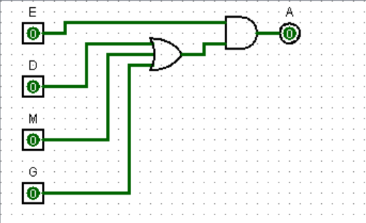

Basic Gate Circuit Architecture
Step 1 (3-Input OR Gate): Combines Door ( ), Motion ( ), and Glass ( ) inputs. If any sensor is HIGH (1), the OR gate output becomes HIGH.
Signal:
Step 2 (2-Input AND Gate): Takes the OR gate output and multiplies it with Master Enable ( ).
Signal:
No Clock Pulse Needed: As 1st-year DDCA students, we designed this as a pure asynchronous combinational logic circuit — no clock pulses, memory elements.

Slide 6






Simulation & Performance Analysis
Software Verification
Timing & Performance
Hardware ICs Needed
Verified using Logisim / Multisim simulator across all input combinations.
Real-time response suited for immediate intruder alert.
Minimal basic gate hardware chips for simple lab setup.
•
100% agreement with truth table
•
Propagation delay: ~18ns
•
1x 74LS32 (Quad OR IC)
•
Glitch-free signal transitions
•
Immediate physical output trigger
•
1x 74LS08 (Quad AND IC)

Slide 7
Thank You!
Smart Home Security System — DDCA Course Project

